Slide 1
GFM Autotuning

Slide 2
Inputs
Required imputed
maxTrq maximum allow torque
maxVel maximum positive speed
maxPos maximum positive position
minVel maximum negative speed
minPos maximum negative position;
phi_m_v speed loop phase margin (now 75°)
MinWc minimum value of the controller bandwidth
MaxWc maximum value of the controller bandwidth
pOscillationTollerance allow torque oscillation tolerance, torque standard deviation will be smaller than maxTrq*pOscillationTollerance (now 0.3)
pLow_Vel_Thr threshold between low- and high-speed conditions.

Slide 3
Autotuning states
State 0: Noise Level Identification
Description: Identify velocity noise. The motor does not move, noise is the maximum absolute value of the velocity
Control mode: torque
Transitions: to state TimeId (default: 1.0) seconds.
State 1: Static friction identification
Description: Identify static friction (namely, the Coulomb coefficient). The torque is increased until the motor start to move.
Control mode: torque
Transitions: to state 1 for friction_trial times, then go to state 2.

Slide 4
Autotuning states
State 2: Inertia identification
Description: Identify viscous friction coefficient and the motor inertia. The motor moves in positive and negative directions.
Control mode: torque
Transitions: to state 1 after Time_identification (default: 7.0) seconds.
State 3: Inertia identification - stopping
Description: stop motor after identification.
Control mode: torque
Transitions:
to state 4 if the identified parameters are correct setting the bandwidth equal to the minimum value
to state 100 otherwise.

Slide 5
Autotuning states
State 100: reset to wrong model identification
Description: reset the autotuner and repeat identification
Control mode: torque
Transitions: to state 0 if estimation_trials is less than 3, otherwise go to state 92.
State 4: tuning at low-speed levels
Description: update low-speed controller parameters and switch to speed mode.
Control mode: torque
Transitions: to state 5 when the parameters have been updated

Slide 6
Autotuning states
State 5: stop movements
Description: ensure that the motor is stopped
Control mode: speed
Transitions: to state 6 after TrialTime (default: 2.0) seconds, or 0.2*TrialTime seconds if the speed is smaller than the noise level. Set velocity setpoint to a random value, smaller than the threshold between low and high velocity (maxVel*low_vel_thr)
State 6: rise time
Description: compute the rise time at 95% of the setpoint value.
Control mode: speed
Transitions:
to state 7 when speed reach 95% of the setpoint
To state 9 if the speed overshoot is greater than 30%.

Slide 7
Autotuning states
State 7: waiting steady state
Description: wait the end of the transient
Control mode: speed
Transitions:
to state 8 after min(0.4*TrialTime,3.0*rise time) seconds.
To state 9 if the speed overshoot is greater than 30%.

Slide 8
Autotuning states
State 8: computing variance
Description: compute torque variance and standard deviation SIGMA
Control mode: speed
Transitions:
to state 4 after min(0.7*TrialTime,5.0*rise time) seconds If the standard deviation SIGMA is smaller than the threshold and the control bandwidth is smaller than the maximum value, increasing the controller bandwidth
To state 9 after min(0.7*TrialTime,5.0*rise time) seconds If the standard deviation SIGMA is greater than the threshold and the control bandwidth is greater than the maximum value. Change to high speed tuning, set bandwidth equal to the minimum value
State 9: tuning at high-speed levels
Description: update high-speed controller parameters
Control mode: speed
Transitions: to state 5 when the parameters have been updated

Slide 9
Autotuning states
State 10: stop movements
Description: ensure that the motor is stopped
Control mode: speed
Transitions: to state 11 after TrialTime (default: 2.0) seconds, or 0.2*TrialTime seconds if the speed is smaller than the noise level. Set velocity setpoint to a random value, greater than the threshold between low and high velocity (maxVel*low_vel_thr)
State 11: rise time
Description: compute the rise time at 95% of the setpoint value.
Control mode: speed
Transitions: Transitions:
to state 12 when speed reach 95% of the setpoint
To state 9 if the speed overshoot is greater than 30%.

Slide 10
Autotuning states
State 12: waiting steady state
Description: wait the end of the transient
Control mode: speed
Transitions:
to state 8 after min(0.4*TrialTime,3.0*rise time) seconds.
To state 9 if the speed overshoot is greater than 30%.

Slide 11
Autotuning states
State 13: computing variance
Description: compute torque variance and standard deviation SIGMA
Control mode: speed
Transitions:
to state 9 after min(0.7*TrialTime,5.0*rise time) seconds If the standard deviation SIGMA is smaller than the threshold and the control bandwidth is smaller than the maximum value, increasing the controller bandwidth
To state 14 after min(0.7*TrialTime,5.0*rise time) seconds If the standard deviation SIGMA is greater than the threshold and the control bandwidth is greater than the maximum value.
State 9: save tuning at high-speed levels
Description: update high-speed controller parameters
Control mode: speed
Transitions: to state 15 when the parameters have been updated

Slide 12
Autotuning states
State 15: tuning completed
Description: tuning completed, final state.
Control mode: speed
Transitions: NONE
State 91: velocity tracking error
Description: unable to reach steady state during the tuning phase
Control mode: speed
Transitions: NONE
State 92: parameter identification error
Description: unable to identify the model
Control mode: torque
Transitions: NONE

Slide 13
Autotuning states
State 99: constraints violation
Description: constraints violation
Control mode: speed/torque
Transitions: NONE

Slide 14
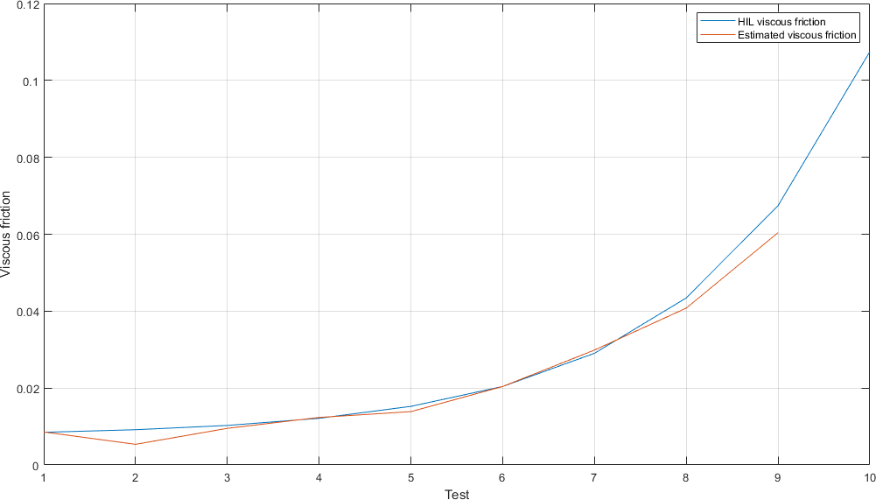
Test in HIL
Estimated friction compared to the HIL value
COMPLETE TEST CAMPAIN

Slide 15
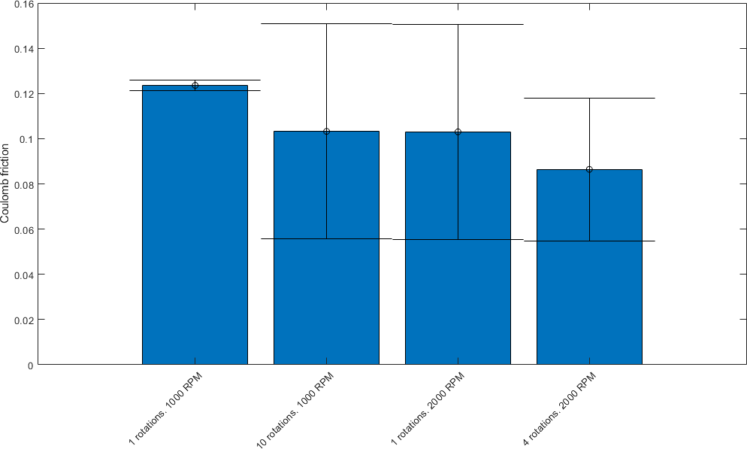
Relation between constraints amplitude and identified model
Coulomb friction
Coulomb friction requires multiple test to having a correct estimation.

Slide 16
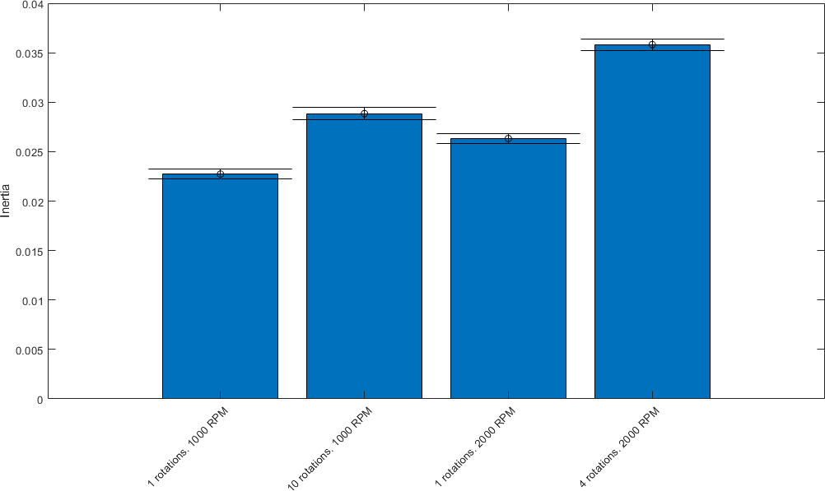
Relation between constraints amplitude and identified model
Inertia
Low speed and low torques reduces estimation accuracy.

Slide 17
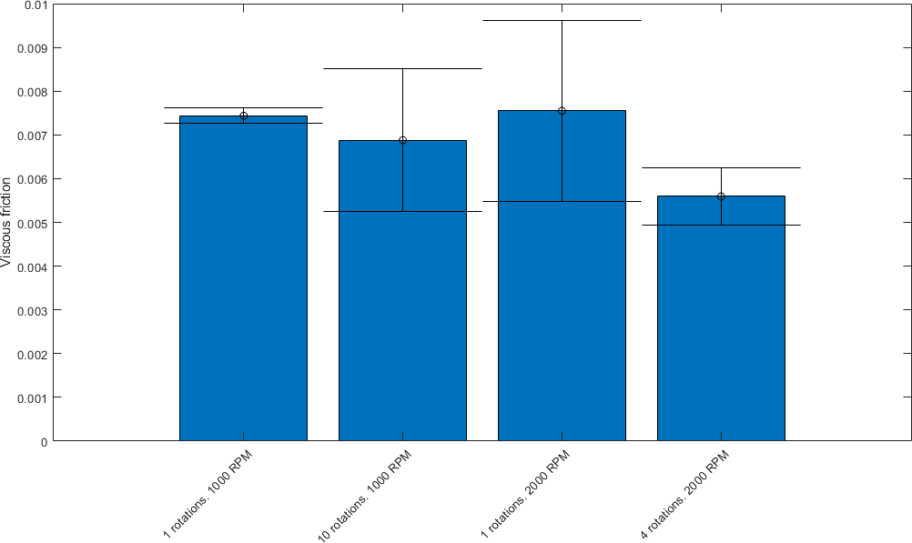
Relation between constraints amplitude and identified model
Viscous friction
Low speed and low torques reduces estimation accuracy.
It depends on the accuracy of Coulomb friction identification

